Slide 1
Structured Support Vector Machine
Hung-yi Lee
Notes:
Question:
What is the original cutting plane algorithm?

Slide 2
Structured Learning
We need a more powerful function f
Input and output are both objects with structures
Object: sequence, list, tree, bounding box …
X is the space of one kind of object
Y is the space of another kind of object
Notes:
Can DNN do that?

Slide 3
Unified Framework
Step 1: Training
Find a function F
Step 2: Inference (Testing)
Given an object x
F(x,y): evaluate how compatible the objects x and y is
Notes:
What is F? different people give it different name, Yan LaCu call it Enerygy model
This framework is every where

Slide 4
Three Problems
Problem 1: Evaluation
Problem 2: Inference
Problem 3: Training
What does F(x,y) look like?
Given training data, how to find F(x,y)
How to solve the “arg max” problem
Notes:
Have you ever heard this three questions before
No general task dependent
Ring a bell!!!!!!!!!!

Slide 5
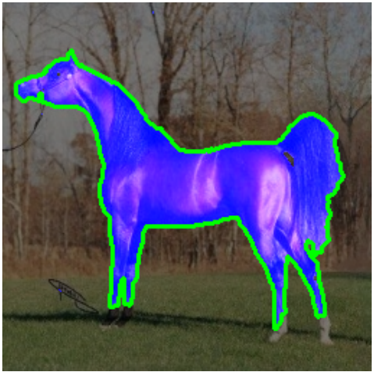
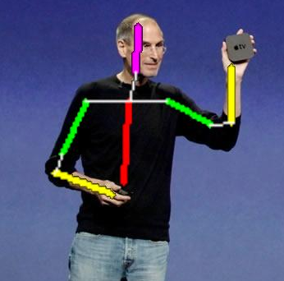

Example Task: Object Detection
Example Task
Keep in mind that what you will learn today can be applied to other tasks.
Source of image:
http://citeseerx.ist.psu.edu/viewdoc/download?doi=10.1.1.295.6007&rep=rep1&type=pdf
http://www.vision.ee.ethz.ch/~hpedemo/gallery.php
Notes:
Easy to vidualize

Slide 6





Problem 1: Evaluation
F(x,y) is linear
$$x→$$
$$y→$$
$$F\left( \right)$$
$$=w∙φ\left( \right)$$
Open question: What if F(x,y) is not linear?

Slide 7


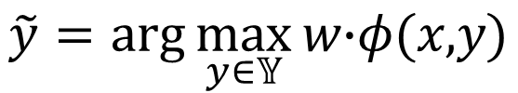






Problem 2: Inference
$$\tilde{y}=arg\max_{y∈𝕐}{\text{w}\text{∙}φ\text{(}\text{x}\text{,}\text{y}\text{)}}$$
……
……
$$\text{w}\text{∙}φ\text{(} \text{)}$$
=1.1
$$\text{w}\text{∙}φ\text{(} \text{)}$$
=8.2
…
…
max
=0.3
……
……
$$\text{w}\text{∙}φ\text{(} \text{)}$$
$$\text{w}\text{∙}φ\text{(} \text{)}$$
=10.1
$$\tilde{y}$$
…
…
……
……
$$\text{w}\text{∙}φ\text{(} \text{)}$$
=-1.5
$$\text{w}\text{∙}φ\text{(} \text{)}$$
=5.6
Notes:
Can you do any faster
Branch and bound

Slide 8
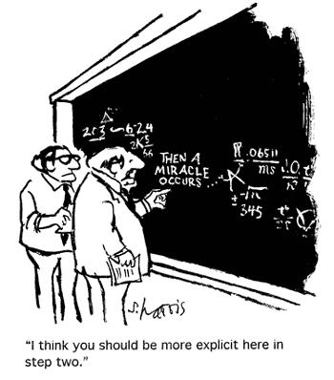
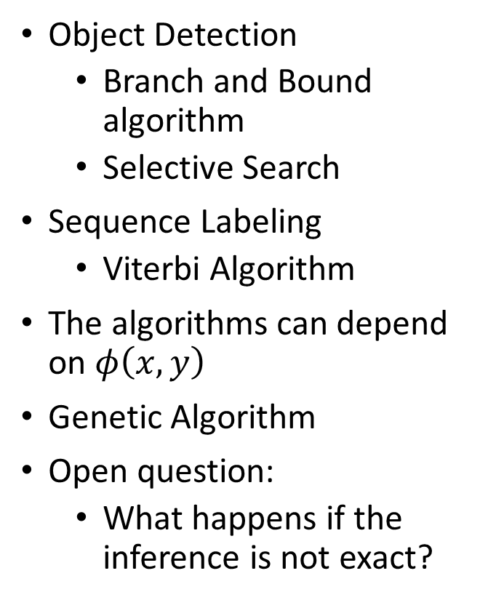
Problem 2: Inference
Object Detection
Branch and Bound algorithm
Selective Search
Sequence Labeling
Viterbi Algorithm
The algorithms can depend on $φ\left(x,y\right)$
Genetic Algorithm
Open question:
What happens if the inference is not exact?
http://www.condenaststore.com/-sp/I-think-you-should-be-more-explicit-here-in-step-two-Cartoon-Prints_i8562937_.htm
Notes:
Branch and Bound algorithm
http://www.kyb.mpg.de/fileadmin/user_upload/files/publications/attachments/ECCV2008-Blaschko_5247%5b0%5d.pdf
Selective Search:
http://www.cs.cornell.edu/courses/cs7670/2014sp/slides/VisionSeminar14.pdf

Slide 9
Problem 3: Training
Principle
Training data:
We should find F(x,y) such that ……
……
for all
for all
for all
Let’s ignore problems 1 and 2 and only focus on problem 3 today.

Slide 10
Outline
Separable case
Non-separable case
Considering Errors
Cutting Plane Algorithm for Structured SVM
Structured SVM
Regularization
Multi-class and binary SVM
Beyond Structured SVM (open question)
Notes:
Separable cases
Structured Perceptron
Non-separable cases
Margin
(another point of view)
Regularization
SVM:
SVM with lots of constaints

Slide 11
Outline
Separable case
Non-separable case
Considering Errors
Cutting Plane Algorithm for Structured SVM
Structured SVM
Regularization
Multi-class and binary SVM
Beyond Structured SVM (open question)
Notes:
Separable cases
Structured Perceptron
Non-separable cases
Margin
(another point of view)
Regularization
SVM:
SVM with lots of constaints

Slide 12

Assumption: Separable
There exists a weight vector $\hat{w}$
Notes:
If we can then we are done
Can structured perceptron algorithm achieve that?
Can structured perceptron find the weight w having the same direction as w*?
If there is not w*, may be you should redesign your ph

Slide 13
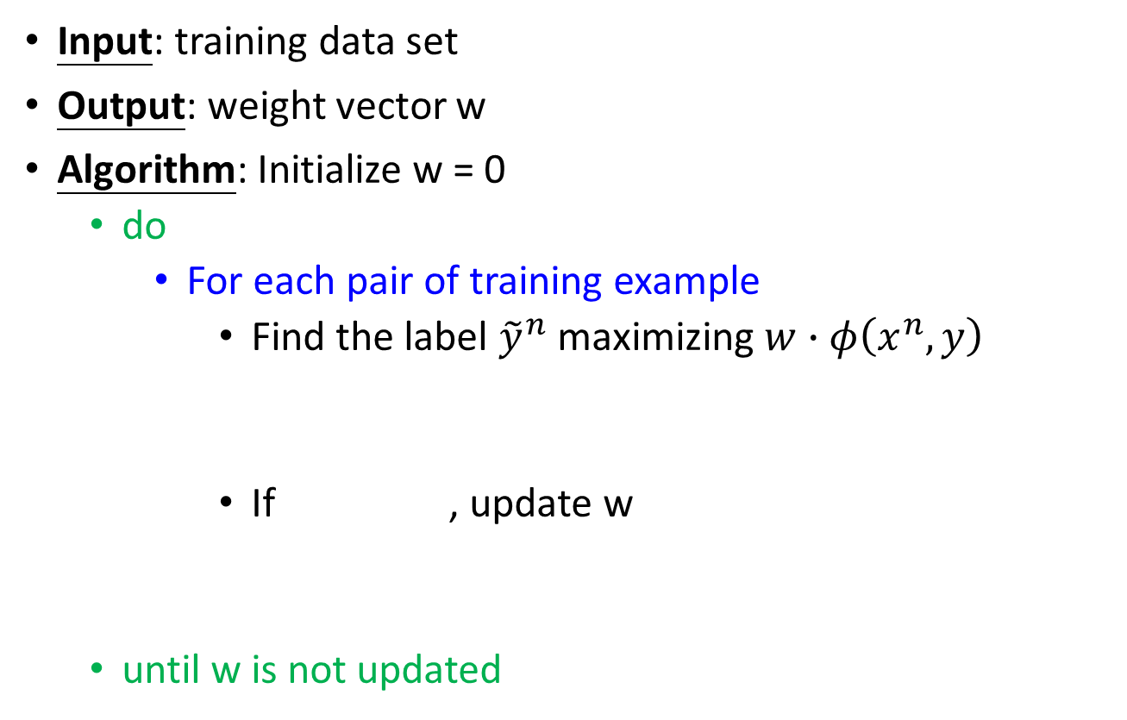
Structured Perceptron
Input: training data set
Output: weight vector w
Algorithm: Initialize w = 0
do
For each pair of training example
Find the label ${\tilde{y}}^{n}$ maximizing $w∙φ\left(x^{n},y\right)$
If , update w
until w is not updated
(problem 2)
We are done!
Notes:
Will it terminate?
Question 1 and 2 is solved.
Important: if the weight if not update, end the algorithm

Slide 14
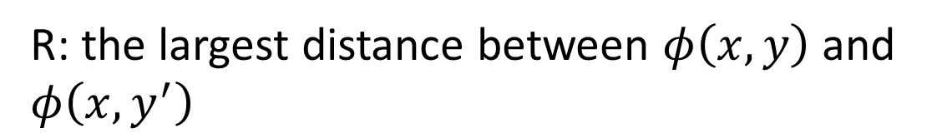
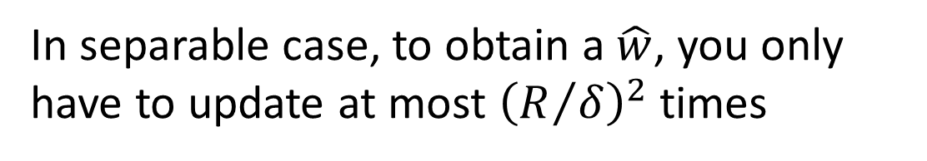
Warning of Math
In separable case, to obtain a $\hat{w}$, you only have to update at most ${\left(R/δ\right)}^{2}$ times
δ: margin
R: the largest distance between $φ\left(x,y\right)$ and $φ\left(x,y^{′}\right)$
Not related to the space of y!

Slide 15
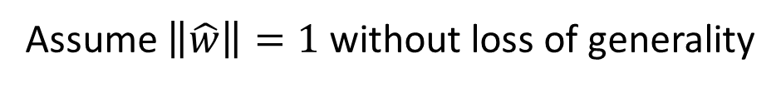
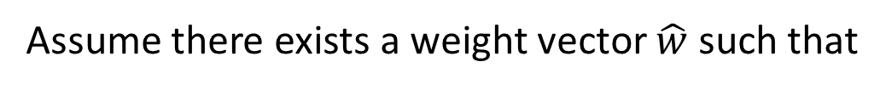
Proof of Termination
w is updated once it sees a mistake
(the relation of w^{k} and w^{k-1})
Remind: we are considering the separable case
Assume there exists a weight vector $\hat{w}$ such that
(All training examples)
(All incorrect label for an example)
Assume $\left\|\hat{w}\right\|=1$ without loss of generality
Notes:
It is not update every time (some of them is not updated when seeing the enough examples)

Slide 16
Proof of Termination
w is updated once it sees a mistake
(the relation of w^{k} and w^{k-1})
Proof that:
The angle ρ_{k} between and w^{k} is smaller as k increases
Analysis
(larger and larger?)
(Separable)
Notes:
It is not update every time (some of them is not updated when seeing the enough examples)

Slide 17
Proof of Termination
w is updated once it sees a mistake
(the relation of w^{k} and w^{k-1})
Proof that:
The angle ρ_{k} between and w^{k} is smaller as k increases
Analysis
(larger and larger?)
=0
≥δ
(so what)
Notes:
It is not update every time (some of them is not updated when seeing the enough examples)

Slide 18
Proof of Termination
?
(mistake)
Assume the distance between any two feature vectors is smaller than R
Notes:
X = a + b
||x||2 = (a+b)T(a+b) = (aT + bT) (a + b)
= aTa + bTb + 2 a dot b

Slide 19
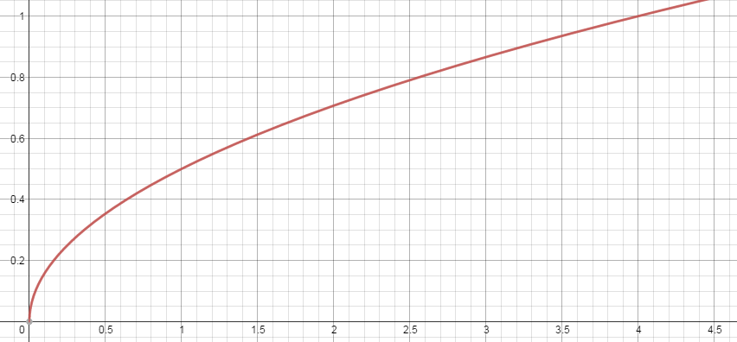
Proof of Termination

Slide 20
End of Warning
In separable case, to obtain a $\hat{w}$, you only have to update at most ${\left(R/δ\right)}^{2}$ times
δ: margin
R: the largest distance between $φ\left(x,y\right)$ and $φ\left(x,y^{′}\right)$
Not related to the space of y!

Slide 21
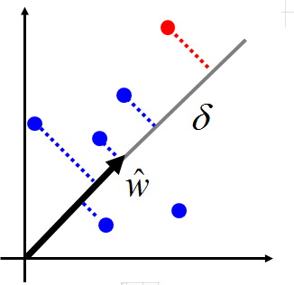
How to make training fast?
The largest distances between features
Normalization
Margin: Is it easy to separable red points from the blue ones
Larger margin, less update
All feature times 2

Slide 22
Outline
Separable case
Non-separable case
Considering Errors
Cutting Plane Algorithm for Structured SVM
Structured SVM
Regularization
Multi-class and binary SVM
Beyond Structured SVM (open question)
Notes:
Separable cases
Structured Perceptron
Non-separable cases
Margin
(another point of view)
Regularization
SVM:
SVM with lots of constaints

Slide 23



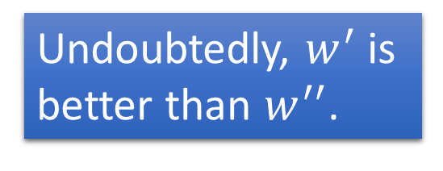






Non-separable Case
Undoubtedly, $w^{′}$ is better than $w^{′′}$.
When the data is non-separable, some weights are still better than the others.
$$w^{′}∙φ\left( \right)$$
$$w^{′′}∙φ\left( \right)$$
$$w^{′}∙φ\left( \right)$$
$$w^{′′}∙φ\left( \right)$$
$$w^{′}∙φ\left( \right)$$
$${w′}^{′}∙φ\left( \right)$$
$$w^{′}∙φ\left( \right)$$
$$w^{′′}∙φ\left( \right)$$

Slide 24







Defining Cost Function
Define a cost C to evaluate how bad a w is, and then pick the w minimizing the cost C
$$C^{n}=\max_{y}\left[w∙φ\left(x^{n},y\right)\right]$$
$$w∙φ\left( \right)$$
$$−w∙φ\left(x^{n},{\hat{y}}^{n}\right)$$
$$C=\sum_{n=1}^{N}{C^{n}}$$
$$w∙φ\left( \right)$$
$$w∙φ\left( \right)$$
What is the minimum value?
$$w∙φ\left( \right)$$
Other alternatives?

Slide 25
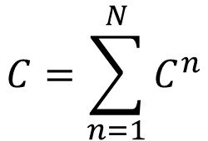

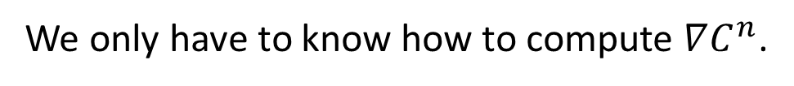



(Stochastic) Gradient Descent
Find w minimizing the cost $C$
$$C=\sum_{n=1}^{N}{C^{n}}$$
$$C^{n}=\max_{y}\left[w∙φ\left(x^{n},y\right)\right]$$
$$−w∙φ\left(x^{n},{\hat{y}}^{n}\right)$$
(Stochastic) Gradient descent:
We only have to know how to compute $∇C^{n}$.
However, there is “max” in $C^{n}$ …….

Slide 26

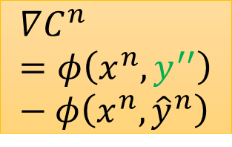


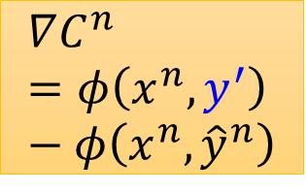


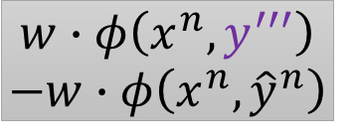

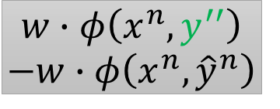
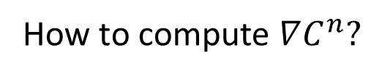
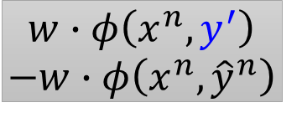
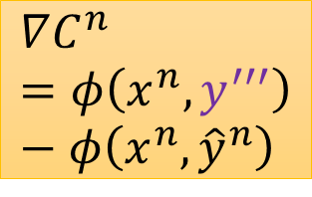
$$C^{n}=\max_{y}\left[w∙φ\left(x^{n},y\right)\right]$$
$$−w∙φ\left(x^{n},{\hat{y}}^{n}\right)$$
How to compute $∇C^{n}?$
When w is different, the y can be different.
Space of w
$$∇C^{n}=φ\left(x^{n},y^{′′}\right)−φ\left(x^{n},{\hat{y}}^{n}\right)$$
$$∇C^{n}=φ\left(x^{n},y^{′′′}\right)−φ\left(x^{n},{\hat{y}}^{n}\right)$$
$$∇C^{n}=φ\left(x^{n},y^{′}\right)−φ\left(x^{n},{\hat{y}}^{n}\right)$$
$$w∙φ\left(x^{n},y^{′′}\right)$$
$$−w∙φ\left(x^{n},{\hat{y}}^{n}\right)$$
$$w∙φ\left(x^{n},y^{′′′}\right)$$
$$−w∙φ\left(x^{n},{\hat{y}}^{n}\right)$$
$$y^{′′}$$
$$y^{′′′}$$
$$w∙φ\left(x^{n},y^{′}\right)$$
$$−w∙φ\left(x^{n},{\hat{y}}^{n}\right)$$
$$y^{′}$$
$$arg\max_{y}\left[w∙φ\left(x^{n},y\right)\right]$$

Slide 27
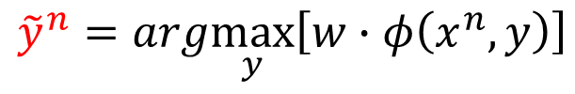





(Stochastic) Gradient Descent
For t = 1 to T:
Update the parameters T times
Randomly pick a training data $\left\{x^{n},{\hat{y}}^{n}\right\}$
stochastic
$${\tilde{y}}^{n}=arg\max_{y}\left[w∙φ\left(x^{n},y\right)\right]$$
Locate the region
$$∇C^{n}\text{=}φ\left(x^{n},{\tilde{y}}^{n}\right)−φ\left(x^{n},{\hat{y}}^{n}\right)$$
simple
$$w→w−η∇C^{n}$$
$$=w−η\left[φ\left(x^{n},{\tilde{y}}^{n}\right)−φ\left(x^{n},{\hat{y}}^{n}\right)\right]$$
If we set $η=1$, then we are doing structured perceptron.

Slide 28
Outline
Separable case
Non-separable case
Considering Errors
Cutting Plane Algorithm for Structured SVM
Structured SVM
Regularization
Multi-class and binary SVM
Beyond Structured SVM (open question)
Notes:
Separable cases
Structured Perceptron
Non-separable cases
Margin
(another point of view)
Regularization
SVM:
SVM with lots of constaints

Slide 29










Based on what we have considered …...
$$F\left(x,y\right)$$
$$F\left(x,y\right)$$
$$w∙φ\left( \right)$$
$$w∙φ\left( \right)$$
$$w∙φ\left( \right)$$
$$w∙φ\left( \right)$$
acceptable
Treat all incorrect y equally
$$w∙φ\left( \right)$$
$$w∙φ\left( \right)$$
$$w∙φ\left( \right)$$
$$w∙φ\left( \right)$$
very bad!
The right case is better.
Notes:
Reason:
1. Natural
2. More robust
That is, Even tough the error happens ….., get reasonable results

Slide 30



Considering the incorrect ones
$$w∙φ\left( \right)$$
smaller
larger
$$w∙φ\left( \right)$$
Different from correct box
Close to correct box
$$w∙φ\left( \right)$$
How to measure the difference

Slide 31




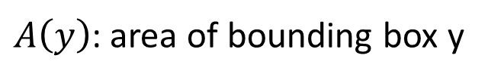
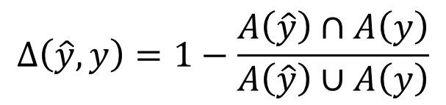
Defining Error Function
$Δ\left(\hat{y},y\right)$: difference between $\hat{y}$ and $y$
( > 0 )
$$y$$
$A\left(y\right)$: area of bounding box y
$$Δ\left(\hat{y},y\right)=1−\frac{A\left(\hat{y}\right)∩A\left(y\right)}{A\left(\hat{y}\right)∪A\left(y\right)}$$
$$\hat{y}$$
Notes:
or how bad it is if $y$ is taken as $\hat{y}$

Slide 32







Another Cost Function
$$C^{n}=\max_{y}\left[w∙φ\left(x^{n},y\right)\right]$$
$$−w∙φ\left(x^{n},{\hat{y}}^{n}\right)$$
$$C^{n}=\max_{y}\left[∆\left({\hat{y}}^{n},y\right)+w∙φ\left(x^{n},y\right)\right]−w∙φ\left(x^{n},{\hat{y}}^{n}\right)$$
$$∆\left( \right)$$
$$w∙φ\left( \right)$$
margin
$$∆\left( \right)$$
$$w∙φ\left( \right)$$
margin
$$w∙φ\left( \right)$$

Slide 33


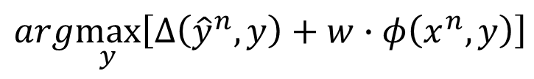
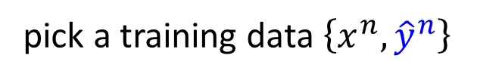





Gradient Descent
$$C^{n}=\max_{y}\left[w∙φ\left(x^{n},y\right)\right]$$
$$−w∙φ\left(x^{n},{\hat{y}}^{n}\right)$$
$$C^{n}=\max_{y}\left[∆\left({\hat{y}}^{n},y\right)+w∙φ\left(x^{n},y\right)\right]−w∙φ\left(x^{n},{\hat{y}}^{n}\right)$$
In each iteration,
pick a training data $\left\{x^{n},{\hat{y}}^{n}\right\}$
$${\tilde{y}}^{n}=arg\max_{y}\left[w∙φ\left(x^{n},y\right)\right]$$
$$arg\max_{y}\left[∆\left({\hat{y}}^{n},y\right)+w∙φ\left(x^{n},y\right)\right]$$
$${\overline{y}}^{n}$$
Oh no! Problem 2.1
$$∇C^{n}\left(w\right)\text{=}φ\left(x^{n},{\tilde{y}}^{n}\right)−φ\left(x^{n},{\hat{y}}^{n}\right)$$
$${\overline{y}}^{n}$$
$$w→$$
$$w−η\left[φ\left(x^{n},{\tilde{y}}^{n}\right)−φ\left(x^{n},{\hat{y}}^{n}\right)\right]$$
$${\overline{y}}^{n}$$

Slide 34



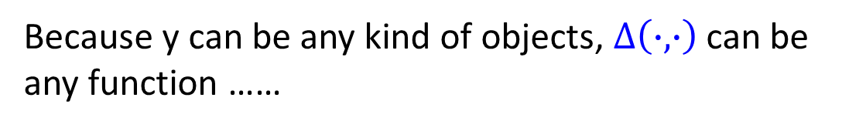
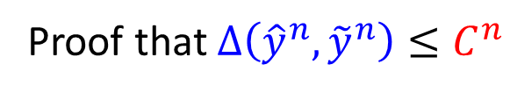
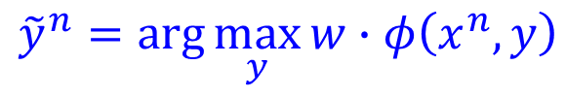

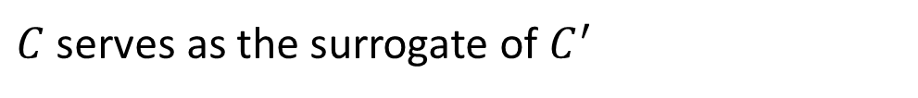
Another Viewpoint
$${\tilde{y}}^{n}=arg\max_{y}{w∙φ\left(x^{n},y\right)}$$
Minimizing the new cost function is minimizing the upper bound of the errors on training set
$$C′=\sum_{n=1}^{N}{∆\left({\hat{y}}^{n},{\tilde{y}}^{n}\right)}$$
$$≤$$
$$C=\sum_{n=1}^{N}{C^{n}}$$
upper bound
We want to find $w$ minimizing $C^{′}$ (errors)
It is hard!
Because y can be any kind of objects, $Δ\left(∙,∙\right)$ can be any function ……
$C$ serves as the surrogate of $C^{′}$
Proof that $∆\left({\hat{y}}^{n},{\tilde{y}}^{n}\right)≤C^{n}$
Notes:
Find a weight vector $w^{∗}$ minimizing a cost function $C\left(w\right)$
Given training data $\left\{\left(x^{1},y^{1}\right),\left(x^{2},y^{2}\right),⋯\left(x^{R},y^{R}\right)\right\}$
$$C\left(w\right)=\sum_{r=1}^{R}{∆\left(y^{r},{\tilde{y}}^{r}\right)}$$

Slide 35
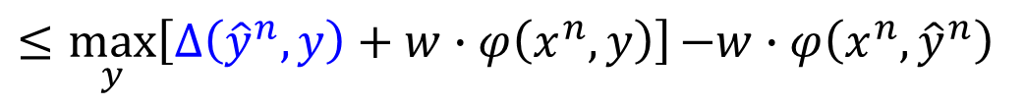
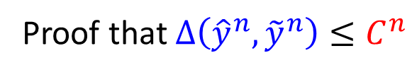




Another Viewpoint
$$C^{n}=\max_{y}\left[∆\left({\hat{y}}^{n},y\right)+w∙φ\left(x^{n},y\right)\right]{−w∙φ\left(x^{n},{\hat{y}}^{n}\right)}$$
Proof that $∆\left({\hat{y}}^{n},{\tilde{y}}^{n}\right)≤C^{n}$
$$∆\left({\hat{y}}^{n},{\tilde{y}}^{n}\right)$$
$$≤∆\left({\hat{y}}^{n},{\tilde{y}}^{n}\right)+\left[w∙φ\left(x^{n},{\tilde{y}}^{n}\right)−w∙φ\left(x^{n},{\hat{y}}^{n}\right)\right]$$
$$≥0$$
$${\tilde{y}}^{n}=arg\max_{y}{w∙φ\left(x^{n},y\right)}$$
$$=\left[∆\left({\hat{y}}^{n},{\tilde{y}}^{n}\right)+w∙φ\left(x^{n},{\tilde{y}}^{n}\right)\right]−w∙φ\left(x^{n},{\hat{y}}^{n}\right)$$
$$≤\max_{y}\left[∆\left({\hat{y}}^{n},y\right)+w∙φ\left(x^{n},y\right)\right]{−w∙φ\left(x^{n},{\hat{y}}^{n}\right)}$$
$$=C^{n}$$

Slide 36

More Cost Functions
$$∆\left({\hat{y}}^{n},{\tilde{y}}^{n}\right)≤C^{n}$$
Margin rescaling:
$$C^{n}=\max_{y}\left[∆\left({\hat{y}}^{n},y\right)+w∙φ\left(x^{n},y\right)\right]{−w∙φ\left(x^{n},{\hat{y}}^{n}\right)}$$
Slack variable rescaling:
$$C^{n}=\max_{y}∆\left({\hat{y}}^{n},y\right)\left[1+w∙φ\left(x^{n},y\right)−w∙φ\left(x^{n},{\hat{y}}^{n}\right)\right]$$

Slide 37
Outline
Separable case
Non-separable case
Considering Errors
Cutting Plane Algorithm for Structured SVM
Structured SVM
Regularization
Multi-class and binary SVM
Beyond Structured SVM (open question)
Notes:
Separable cases
Structured Perceptron
Non-separable cases
Margin
(another point of view)
Regularization
SVM:
SVM with lots of constaints

Slide 38
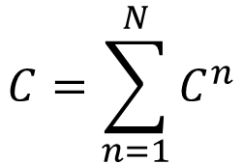
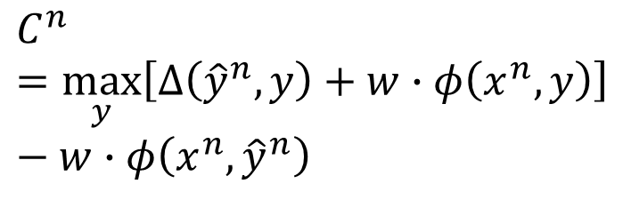
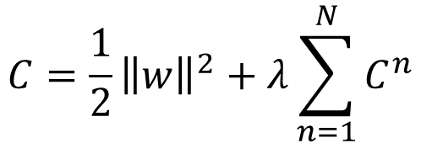
Regularization
Training data and testing data can have different distribution.
w close to zero can minimize the influence of mismatch.
Keep the incorrect answer from a margin depending on errors
$$C=\sum_{n=1}^{N}{C^{n}}$$
$$C=\frac{1}{2}{\left\|w\right\|}^{2}+λ\sum_{n=1}^{N}{C^{n}}$$
$$C^{n}=\max_{y}\left[∆\left({\hat{y}}^{n},y\right)+w∙φ\left(x^{n},y\right)\right]−w∙φ\left(x^{n},{\hat{y}}^{n}\right)$$
Regularization:
Find the w close to zero

Slide 39




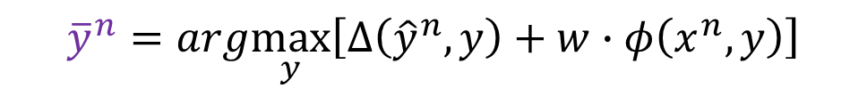





Regularization
$$C=\sum_{n=1}^{N}{C^{n}}$$
$$C=\frac{1}{2}{\left\|w\right\|}^{2}+λ\sum_{n=1}^{N}{C^{n}}$$
In each iteration,
pick a training data $\left\{x^{n},{\hat{y}}^{n}\right\}$
$${\overline{y}}^{n}=arg\max_{y}\left[∆\left({\hat{y}}^{n},y\right)+w∙φ\left(x^{n},y\right)\right]$$
$$∇C^{n}\text{=}φ\left(x^{n},{\overline{y}}^{n} \right)−φ\left(x^{n},{\hat{y}}^{n}\right)$$
$$+w$$
$$w→$$
$$w−η\left[φ\left(x^{n},{\overline{y}}^{n} \right)−φ\left(x^{n},{\hat{y}}^{n}\right)\right]$$
$$−ηw$$
$$=\left(1−η\right)w−η\left[φ\left(x^{n},{\overline{y}}^{n} \right)−φ\left(x^{n},{\hat{y}}^{n}\right)\right]$$
Weight decay as in DNN

Slide 40
Outline
Separable case
Non-separable case
Considering Errors
Cutting Plane Algorithm for Structured SVM
Structured SVM
Regularization
Multi-class and binary SVM
Beyond Structured SVM (open question)
Notes:
Separable cases
Structured Perceptron
Non-separable cases
Margin
(another point of view)
Regularization
SVM:
SVM with lots of constaints

Slide 41


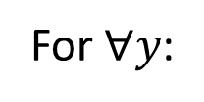
Structured SVM
Find $w$ minimizing $C$
$$C=\frac{1}{2}{\left\|w\right\|}^{2}+λ\sum_{n=1}^{N}{C^{n}}$$
$$C^{n}=\max_{y}\left[∆\left({\hat{y}}^{n},y\right)+w∙φ\left(x^{n},y\right)\right]{−w∙φ\left(x^{n},{\hat{y}}^{n}\right)}$$
$$C^{n}+w∙φ\left(x^{n},{\hat{y}}^{n}\right)=\max_{y}\left[∆\left({\hat{y}}^{n},y\right)+w∙φ\left(x^{n},y\right)\right]$$
Are they equivalent?
We want to minimize C
For $∀y$:
$$C^{n}+w∙φ\left(x^{n},{\hat{y}}^{n}\right)≥∆\left({\hat{y}}^{n},y\right)+w∙φ\left(x^{n},y\right)$$
$$w∙φ\left(x^{n},{\hat{y}}^{n}\right)−w∙φ\left(x^{n},y\right)≥∆\left({\hat{y}}^{n},y\right)−C^{n}$$

Slide 42
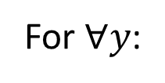








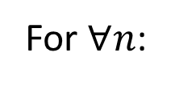
Structured SVM
Find $w$ minimizing $C$
$$C=\frac{1}{2}{\left\|w\right\|}^{2}+λ\sum_{n=1}^{N}{C^{n}}$$
$$C^{n}=\max_{y}\left[∆\left({\hat{y}}^{n},y\right)+w∙φ\left(x^{n},y\right)\right]{−w∙φ\left(x^{n},{\hat{y}}^{n}\right)}$$
$$≡$$
Find $w$ minimizing $C$
$$\text{Find} \text{w}\text{,}ε^{1},⋯,ε^{N}\text{minimiz}\text{ing} C$$
$$C=\frac{1}{2}{\left\|w\right\|}^{2}+λ\sum_{n=1}^{N}{C^{n}}$$
$$ε^{n}$$
For $∀n$:
Slack variable
For $∀y$:
$$w∙φ\left(x^{n},{\hat{y}}^{n}\right)−w∙φ\left(x^{n},y\right)≥∆\left({\hat{y}}^{n},y\right)−C^{n}$$
$$ε^{n}$$

Slide 43

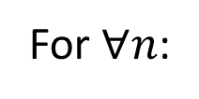








Structured SVM
Find $w$ minimizing $C$
$$\text{Find} \text{w}\text{,}ε^{1},⋯,ε^{N}\text{minimiz}\text{ing} C$$
$$C=\frac{1}{2}{\left\|w\right\|}^{2}+λ\sum_{n=1}^{N}{C^{n}}$$
$$ε^{n}$$
For $∀n$:
For $∀y$:
$$w∙φ\left(x^{n},{\hat{y}}^{n}\right)−w∙φ\left(x^{n},y\right)≥∆\left({\hat{y}}^{n},y\right)−C^{n}$$
$$ε^{n}$$
For $∀y≠{\hat{y}}^{n}$:
$$w∙\left(φ\left(x^{n},{\hat{y}}^{n}\right)−φ\left(x^{n},y\right)\right)≥∆\left({\hat{y}}^{n},y\right){−ε^{n}},$$
$$ε^{n}≥0$$
If $y={\hat{y}}^{n}: w∙φ\left(x^{n},{\hat{y}}^{n}\right)−w∙φ\left(x^{n},{\hat{y}}^{n}\right)≥∆\left({\hat{y}}^{n},{\hat{y}}^{n}\right)−ε^{n}$
=0
=0
$$ε^{n}≥0$$

Slide 44

Structured SVM - Intuition
$$∆\left( \right)$$
$$w∙φ\left( \right)$$
margin
$$∆\left( \right)$$
$$w∙φ\left( \right)$$
margin
$$w∙φ\left( \right)$$
It is possible that no w can achieve this.
$$w∙\left(φ\left( \right)−φ\left( \right)\right)≥∆\left( \right)$$
$$∀y≠\hat{y}$$
$$w∙\left(φ\left( \right)−φ\left( \right)\right)≥∆\left( \right)$$
(lots of inequalities)
margin

Slide 45







Structured SVM - Intuition
$$∆\left( \right)$$
$$−ε$$
$$w∙φ\left( \right)$$
margin
$$∆\left( \right)$$
$$−ε$$
$$w∙φ\left( \right)$$
margin
$$ε≥0$$
$$w∙φ\left( \right)$$
($ε<0$ make the constraints more strict)
$ε$ should be minimized
$$w∙\left(φ\left( \right)−φ\left( \right)\right)≥∆\left( \right)$$
$$−ε$$
$$w∙\left(φ\left( \right)−φ\left( \right)\right)≥∆\left( \right)$$
$$−ε$$
(lots of inequalities)
slack variable
Notes:
$$ε^{1}=∞$$
Any w would be feasible
-infinity

Slide 46














Structured SVM - Intuition
Training data:
$${\hat{y}}^{1}$$
$${\hat{y}}^{2}$$
$$\frac{1}{2}{\left\|w\right\|}^{2}+λ\sum_{n=1}^{2}{ε^{n}}$$
Minimize
$$x^{1}$$
$$x^{2}$$
For $x^{1}$
$$w∙\left(φ\left( \right)−φ\left( \right)\right)≥∆\left( \right){−ε^{1}}$$
$$∀y≠{\hat{y}}^{1}$$
$$w∙\left(φ\left( \right)−φ\left( \right)\right)≥∆\left( \right){−ε^{1}}$$
(lots of inequalities)
$$ε^{1}≥0$$
For $x^{2}$
$$w∙\left(φ\left( \right)−φ\left( \right)\right)≥∆\left( \right){−ε^{2}}$$
$$∀y≠{\hat{y}}^{2}$$
$$w∙\left(φ\left( \right)−φ\left( \right)\right)≥∆\left( \right){−ε^{2}}$$
(lots of inequalities)
$$ε^{2}≥0$$

Slide 47








Structured SVM
$$\text{Find} \text{w}\text{,}ε^{1},⋯,ε^{N} \text{minimiz}\text{ing} C$$
$$C=\frac{1}{2}{\left\|w\right\|}^{2}+λ\sum_{n=1}^{N}{C^{n}\left(w\right)}$$
$$ε^{n}$$
For $∀n$:
For $∀y$:
For $∀y≠{\hat{y}}^{n}$:
$$w∙\left(φ\left(x^{n},{\hat{y}}^{n}\right)−φ\left(x^{n},y\right)\right)≥∆\left({\hat{y}}^{n},y\right){−ε^{n}},$$
$$ε^{n}$$
$$w∙φ\left(x^{n},{\hat{y}}^{n}\right)−w∙φ\left(x^{n},y\right)≥∆\left({\hat{y}}^{n},y\right)−C^{n}\left(w\right)$$
$$ε^{n}≥0$$
Solve it by the solver in SVM package
Quadratic Programming (QP) Problem
Too many constraints ……

Slide 48
Outline
Separable case
Non-separable case
Considering Errors
Cutting Plane Algorithm for Structured SVM
Structured SVM
Regularization
Multi-class and binary SVM
Beyond Structured SVM (open question)
Notes:
Separable cases
Structured Perceptron
Non-separable cases
Margin
(another point of view)
Regularization
SVM:
SVM with lots of constaints

Slide 49









$$\text{Find} \text{w}\text{,}ε^{1},⋯,ε^{N} \text{minimiz}\text{ing} C$$
$$C=\frac{1}{2}{\left\|w\right\|}^{2}+λ\sum_{n=1}^{N}{C^{n}\left(w\right)}$$
$$ε^{n}$$
For $∀n$:
For $∀y$:
For $∀y≠{\hat{y}}^{n}$:
$$w∙\left(φ\left(x^{n},{\hat{y}}^{n}\right)−φ\left(x^{n},y\right)\right)≥∆\left({\hat{y}}^{n},y\right){−ε^{n}},$$
$$ε^{n}$$
$$w∙φ\left(x^{n},{\hat{y}}^{n}\right)−w∙φ\left(x^{n},y\right)≥∆\left({\hat{y}}^{n},y\right)−C^{n}\left(w\right)$$
$$ε^{n}≥0$$
C
Source of image: http://abnerguzman.com/publications/gkb_aistats13.pdf
$$ε$$
w

Slide 50







Cutting Plane Algorithm
Image credit: Yisong Yue
Color is the value of C which is going to be minimized:
Solution with constraints
$$C=\frac{1}{2}{\left\|w\right\|}^{2}+λ\sum_{n=1}^{N}{ε^{n}}$$
Solution without constraints
For $∀r,∀y,y≠{\hat{y}}^{n}$:
$w∙\left(φ\left(x^{n},{\hat{y}}^{n}\right)−φ\left(x^{n},y\right)\right)$
$≥∆\left({\hat{y}}^{n},y\right){−ε^{n}}$
Parameter space
$ε^{n}≥0$
$$\left(w,ε^{1},…ε^{N}\right)$$

Slide 51






Cutting Plane Algorithm
Image credit: Yisong Yue
Although there are lots of constraints, most of them do not influence the solution.
Red lines: determine the solution
Green line: Remove this constraint will not influence the solution
$${y∈𝔸}^{n}$$
For $∀r,∀y,y≠{\hat{y}}^{n}$:
$w∙\left(φ\left(x^{n},{\hat{y}}^{n}\right)−φ\left(x^{n},y\right)\right)$
$≥∆\left({\hat{y}}^{n},y\right){−ε^{n}}$
Parameter space
$$\left(w,ε^{1},…,ε^{N}\right)$$
$ε^{n}≥0$
$𝔸^{n}$: a very small set of $y$
→working set
Notes:
Then the QP is solvable.

Slide 52








Cutting Plane Algorithm
Elements in working set $𝔸^{n}$ is selected iteratively
Initialize $𝔸^{1}$ … $𝔸^{N}$
Find $w$, $ε^{1}…ε^{N}$ minimizing C
Solve a QP problem
$$C=\frac{1}{2}{\left\|w\right\|}^{2}+λ\sum_{n=1}^{N}{ε^{n}}$$
For $∀r$:
For $∀y∈𝔸^{n},y≠{\hat{y}}^{n}$:
$$ε^{n}≥0$$
$$w∙\left(φ\left(x^{n},{\hat{y}}^{n}\right)−φ\left(x^{n},y\right)\right)≥∆\left({\hat{y}}^{n},y\right){−ε^{n}}$$
obtain solution w
Repeatedly
Add elements into $𝔸^{1}$ … $𝔸^{N}$

Slide 53


Cutting Plane Algorithm
Image credit: Yisong Yue
Strategies of adding elements into working set $𝔸^{n}$
Initialize $𝔸^{n}=null$
No constraint at all
Solving QP
The solution w is the blue point.

Slide 54

Cutting Plane Algorithm
Image credit: Yisong Yue
Strategies of adding elements into working set $𝔸^{n}$
There are lots of constraints is violated
Find the most violated one
Suppose it is the constraint from y’
Extent the working set
$𝔸^{n}=𝔸^{n}∪\{y^{′}\}$
y’

Slide 55
Cutting Plane Algorithm
Image credit: Yisong Yue
Strategies of adding elements into working set $𝔸^{n}$

Slide 56



Find the most violated one
Given w’ and $ε′$ from working sets at hand, which constraint is the most violated one?
Constraint:
$$w∙\left(φ\left(x,\hat{y}\right)−φ\left(x,y\right)\right)≥∆\left(\hat{y},y\right){−ε}$$
Violate a Constraint:
$$w′∙\left(φ\left(x,\hat{y}\right)−φ\left(x,y\right)\right)<∆\left(\hat{y},y\right){−ε′}$$
Degree of Violation
$$∆\left(\hat{y},y\right){−ε^{′}}−w^{′}∙\left(φ\left(x,\hat{y}\right)−φ\left(x,y\right)\right)$$
$$∆\left(\hat{y},y\right){+}w^{′}∙φ\left(x,y\right)$$
The most violated one:
$$arg\max_{y}\left[∆\left(\hat{y},y\right)+w∙φ\left(x,y\right)\right]$$

Slide 57




Cutting Plane Algorithm
Given training data:
$$\left\{\left(x^{1},{\hat{y}}^{1}\right),\left(x^{2},{\hat{y}}^{2}\right),⋯,\left(x^{N},{\hat{y}}^{N}\right)\right\}$$
Working Set $𝔸^{1}←null, 𝔸^{2}←null,⋯,𝔸^{N}←null$
Repeat
$w←$Solve a QP with Working Set $𝔸^{1}, 𝔸^{2},⋯,𝔸^{N}$
$$\frac{1}{2}{\left\|w\right\|}^{2}+λ\sum_{n=1}^{N}{ε^{n}}$$
QP:
Find 𝑤, 𝜀¹…𝜀^{𝑁} minimizing
For $∀n$:
For $∀y∈𝔸^{n}$:
$$w∙\left(φ\left(x^{n},{\hat{y}}^{n}\right)−φ\left(x^{n},y\right)\right)≥∆\left({\hat{y}}^{n},y\right){−ε^{n}},ε^{n}≥0$$

Slide 58





Cutting Plane Algorithm
Given training data:
$$\left\{\left(x^{1},{\hat{y}}^{1}\right),\left(x^{2},{\hat{y}}^{2}\right),⋯,\left(x^{N},{\hat{y}}^{N}\right)\right\}$$
Working Set $𝔸^{1}←null, 𝔸^{2}←null,⋯,𝔸^{N}←null$
Repeat
$w←$Solve a QP with Working Set $𝔸^{1}, 𝔸^{2},⋯,𝔸^{N}$
For each training data $\left(x^{n},{\hat{y}}^{n}\right)$:
$${\overline{y}}^{n}=arg\max_{y}\left[∆\left({\hat{y}}^{n},y\right)+w∙φ\left(x^{n},y\right)\right]$$
find the most violated constraints
Update working set$𝔸^{n}←𝔸^{n}∪\left\{{\overline{y}}^{n}\right\}$
Until $𝔸^{1}, 𝔸^{2},⋯,𝔸^{N}$doesn’t change any more
Return $w$
Notes:
Gradient decent to QP

Slide 59









Training data:
$${\hat{y}}^{1}$$
$${\hat{y}}^{2}$$
$𝔸^{1}$={}
$𝔸^{2}$={}
$$x^{1}$$
$$x^{2}$$
$$w=0$$
QP:
Find 𝑤, 𝜀¹,𝜀² minimizing
$$\frac{1}{2}{\left\|w\right\|}^{2}+λ\sum_{n=1}^{2}{ε^{n}}$$
There is no constraint
Solution: $w=0$

Slide 60











Training data:
$${\hat{y}}^{1}$$
$${\hat{y}}^{2}$$
$𝔸^{1}$={}
$𝔸^{1}$={ }
$𝔸^{2}$={}
$𝔸^{2}$={ }
$$x^{1}$$
$$x^{2}$$
$$w=0$$
$${\overline{y}}^{1}=arg\max_{y}\left[∆\left({\hat{y}}^{1},y\right)+0∙φ\left(x^{1},y\right)\right]$$
$$∆\left( \right)+w∙φ\left( \right)$$
$$∆\left( \right)+w∙φ\left( \right)$$
=0.90
=0.88
$$∆\left( \right)+w∙φ\left( \right)$$
$$∆\left( \right)+w∙φ\left( \right)$$
=0.25
=1.0
$$∆\left( \right)+w∙φ\left( \right)$$
$$∆\left( \right)+w∙φ\left( \right)$$
=1.0
$${\overline{y}}^{1}$$
=1.0
$${\overline{y}}^{2}=arg\max_{y}\left[∆\left({\hat{y}}^{2},y\right)+0∙φ\left(x^{2},y\right)\right]$$

Slide 61





Training data:
$${\hat{y}}^{1}$$
$${\hat{y}}^{2}$$
$𝔸^{1}$={ }
$𝔸^{2}$={ }
$$x^{1}$$
$$x^{2}$$
$$w=w^{1}$$
$$\frac{1}{2}{\left\|w\right\|}^{2}+λ\sum_{n=1}^{2}{ε^{n}}$$
QP:
Find 𝑤, 𝜀¹,𝜀² minimizing
$$w∙\left(φ\left( \right)−φ\left( \right)\right)≥∆\left( \right){−ε^{1}}$$
$$w∙\left(φ\left( \right)−φ\left( \right)\right)≥∆\left( \right){−ε^{2}}$$
Solution: $w=w^{1}$

Slide 62



Training data:
$${\hat{y}}^{1}$$
$${\hat{y}}^{2}$$
$𝔸^{1}$={ }
}
,
,
}
$𝔸^{2}$={ }
$$x^{1}$$
$$x^{2}$$
$$w=w^{1}$$
$${\overline{y}}^{1}=arg\max_{y}\left[∆\left({\hat{y}}^{1},y\right)+w^{1}∙φ\left(x^{1},y\right)\right]$$
$$∆\left( \right)+w∙φ\left( \right)$$
$$∆\left( \right)+w∙φ\left( \right)$$
=0.97
$${\overline{y}}^{1}$$
=1.55
$$∆\left( \right)+w∙φ\left( \right)$$
$$∆\left( \right)+w∙φ\left( \right)$$
=1.25
=1.01
$$∆\left( \right)+w∙φ\left( \right)$$
$$∆\left( \right)+w∙φ\left( \right)$$
=-0.99
=-1.10
$${\overline{y}}^{2}=arg\max_{y}\left[∆\left({\hat{y}}^{2},y\right)+w^{1}∙φ\left(x^{2},y\right)\right]$$

Slide 63

Training data:
$${\hat{y}}^{1}$$
$${\hat{y}}^{2}$$
$𝔸^{1}$={ }
}
,
,
}
$𝔸^{2}$={ }
$$x^{1}$$
$$x^{2}$$
The process repeats iteratively
$$\frac{1}{2}{\left\|w\right\|}^{2}+λ\sum_{r=1}^{2}{ε^{n}}$$
QP:
Find 𝑤, 𝜀¹,𝜀² minimizing
$$w∙\left(φ\left( \right)−φ\left( \right)\right)≥∆\left( \right){−ε^{1}}$$
$$w∙\left(φ\left( \right)−φ\left( \right)\right)≥∆\left( \right){−ε^{1}}$$
$$w∙\left(φ\left( \right)−φ\left( \right)\right)≥∆\left( \right){−ε^{2}}$$
$$w∙\left(φ\left( \right)−φ\left( \right)\right)≥∆\left( \right){−ε^{2}}$$

Slide 64
Concluding Remarks
Separable case
Non-separable case
Considering Errors
Cutting Plane Algorithm for Structured SVM
Structured SVM
Regularization
Multi-class and binary SVM
Beyond Structured SVM (open question)
Notes:
Separable cases
Structured Perceptron
Non-separable cases
Margin
(another point of view)
Regularization
SVM:
SVM with lots of constaints

Slide 65



















Multi-class SVM
$$F\left(x,y\right)=w∙φ\left(x,y\right)$$
Problem 1: Evaluation
If there are K classes, then we have K weight vectors $\left\{w^{1},w^{2}, ⋯,w^{K}\right\}$
$$w^{1}$$
$$0$$
$$y∈\left\{1,2,⋯,k,⋯,K\right\}$$
$$0$$
$$w^{2}$$
$$F\left(x,y\right)=w^{y}∙\overset{⃑}{x}$$
$$⋯$$
$$⋯$$
$$w=$$
$$φ\left(x,y\right)=$$
$$w^{k}$$
$$\overset{⃑}{x}$$
$\overset{⃑}{x}$: vector representation of $x$
$$⋯$$
$$⋯$$
$$w^{K}$$
$$0$$

Slide 66



Multi-class SVM
Problem 2: Inference
$$F\left(x,y\right)=w^{y}∙\overset{⃑}{x}$$
$$\hat{y}=arg\max_{yε\left\{1,2,⋯,k,⋯,K\right\}}{F\left(x,y\right)}$$
$$=arg\max_{yε\left\{1,2,⋯,k,⋯,K\right\}}{w^{y}∙\overset{⃑}{x}}$$
The number of classes are usually small, so we can just enumerate them.

Slide 67













Multi-class SVM
$$y∈\left\{dog,cat,bus,car\right\}$$
$$∆\left({\hat{y}}^{n}=dog,y=cat\right){=1}$$
$$∆\left({\hat{y}}^{n}=dog,y=bus\right){=100}$$
(defined as your wish)
Problem 3: Training
$$\text{Find} \text{w}\text{,}ε^{1},⋯,ε^{N} \text{minimiz}\text{ing} C$$
$$C=\frac{1}{2}{\left\|w\right\|}^{2}+λ\sum_{n=1}^{N}{C^{n}\left(w\right)}$$
$$ε^{n}$$
For $∀n$:
For $∀y$:
There are only N(K-1) constraints.
For $∀y≠{\hat{y}}^{n}$:
$$\left(w^{{\hat{y}}^{n}}−w^{y}\right)∙\overset{⃑}{x}$$
$$w∙\left(φ\left(x^{n},{\hat{y}}^{n}\right)−φ\left(x^{n},y\right)\right)≥∆\left({\hat{y}}^{n},y\right){−ε^{n}},$$
$$ε^{n}$$
$$w∙φ\left(x^{n},{\hat{y}}^{n}\right)−w∙φ\left(x^{n},y\right)≥∆\left({\hat{y}}^{n},y\right)−C^{n}\left(w\right)$$
$$ε^{n}≥0$$
$$w∙φ\left(x^{n},{\hat{y}}^{n}\right)=w^{{\hat{y}}^{n}}∙\overset{⃑}{x}$$
Some types of misclassifications may be worse than others.
$$w∙φ\left(x^{n},y\right)=w^{y}∙\overset{⃑}{x}$$

Slide 68











Binary SVM
Set K = 2
$$y∈\left\{1,2\right\}$$
For $∀y$:
=1
For $∀y≠{\hat{y}}^{n}$:
$$\left(w^{{\hat{y}}^{n}}−w^{y}\right)∙\overset{⃑}{x}$$
$$w∙\left(φ\left(x^{n},{\hat{y}}^{n}\right)−φ\left(x^{n},y\right)\right)≥∆\left({\hat{y}}^{n},y\right){−ε^{n}},$$
$$ε^{n}$$
$$w∙φ\left(x^{n},{\hat{y}}^{n}\right)−w∙φ\left(x^{n},y\right)≥∆\left({\hat{y}}^{n},y\right)−C^{n}\left(w\right)$$
$$ε^{n}≥0$$
If y=1:
$$\left(w^{1}−w^{2}\right)∙\overset{⃑}{x}≥1{−ε^{n}}$$
$$w∙\overset{⃑}{x}≥1{−ε^{n}}$$
$$w$$
If y=2:
$$\left(w^{2}−w^{1}\right)∙\overset{⃑}{x}≥1{−ε^{n}}$$
$$−w∙\overset{⃑}{x}≥1{−ε^{n}}$$
$$−w$$

Slide 69
Concluding Remarks
Separable case
Non-separable case
Considering Errors
Cutting Plane Algorithm for Structured SVM
Structured SVM
Regularization
Multi-class and binary SVM
Beyond Structured SVM (open question)
Notes:
Separable cases
Structured Perceptron
Non-separable cases
Margin
(another point of view)
Regularization
SVM:
SVM with lots of constaints

Slide 70







Beyond Structured SVM
Involving DNN when generating $φ\left(x,y\right)$
$$x$$
DNN
Structured SVM
$$φ\left(x,y\right)$$
$$F\left(x,y\right)$$
$$y$$
$$θ$$
$$w∙φ\left(x,y\right)$$
Ref: Hao Tang, Chao-hong Meng, Lin-shan Lee, "An initial attempt for phoneme recognition using Structured Support Vector Machine (SVM)," ICASSP, 2010
Shi-Xiong Zhang, Gales, M.J.F., "Structured SVMs for Automatic Speech Recognition," in Audio, Speech, and Language Processing, IEEE Transactions on, vol.21, no.3, pp.544-555, March 2013

Slide 71

Beyond Structured SVM
Jointly training structured SVM and DNN
$$x$$
DNN
Structured SVM
$$φ\left(x,y\right)$$
$$F\left(x,y\right)$$
$$y$$
$$θ$$
$$w∙φ\left(x,y\right)$$
jointly trained
Ref: Shi-Xiong Zhang, Chaojun Liu, Kaisheng Yao, and Yifan Gong, “DEEP NEURAL SUPPORT VECTOR MACHINES FOR SPEECH RECOGNITION”, Interspeech 2015

Slide 72




Beyond Structured SVM
Replacing Structured SVM with DNN
A DNN with x and y as input and $F\left(x,y\right)$ (a scalar) as output
$$x$$
DNN
DNN
$$φ\left(x,y\right)$$
$$F\left(x,y\right)$$
$$y$$
jointly trained
$$θ$$
$θ$’
$$C=\frac{1}{2}{\left\|θ\right\|}^{2}+\frac{1}{2}{\left\|θ′\right\|}^{2}+λ\sum_{n=1}^{N}{C^{n}}$$
Ref: Yi-Hsiu Liao, Hung-yi Lee, Lin-shan Lee, "Towards Structured Deep Neural Network for Automatic Speech Recognition", ASRU, 2015
http://speech.ee.ntu.edu.tw/~tlkagk/paper/DNN_ASRU15.pdf
$$C^{n}=\max_{y}\left[∆\left({\hat{y}}^{n},y\right)+F\left(x^{n},y\right)\right]−F\left(x^{n},{\hat{y}}^{n}\right)$$
Notes:
http://lessoned.blogspot.tw/2011/10/intro-to-sum-product-networks.html

Slide 73
Concluding Remarks
Separable case
Non-separable case
Considering Errors
Cutting Plane Algorithm for Structured SVM
Structured SVM
Regularization
Multi-class and binary SVM
Beyond Structured SVM (open question)
Notes:
Separable cases
Structured Perceptron
Non-separable cases
Margin
(another point of view)
Regularization
SVM:
SVM with lots of constaints

Slide 74
Acknowledgement
感謝 盧柏儒 同學於上課時發現投影片上的錯誤
感謝 徐翊祥 同學於上課時發現投影片上的錯誤

